Slide 1
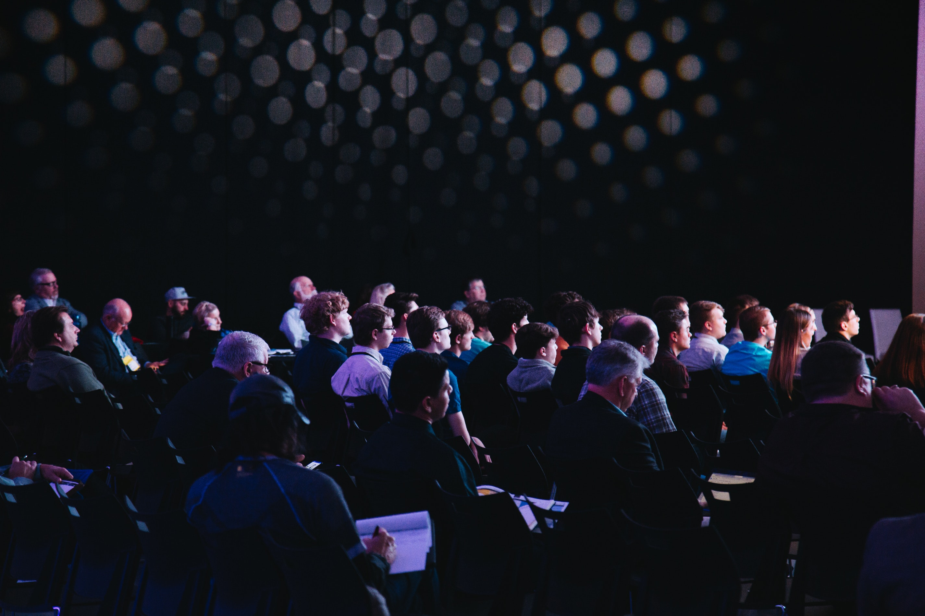


Presenter Name
Designation
1

Slide 2
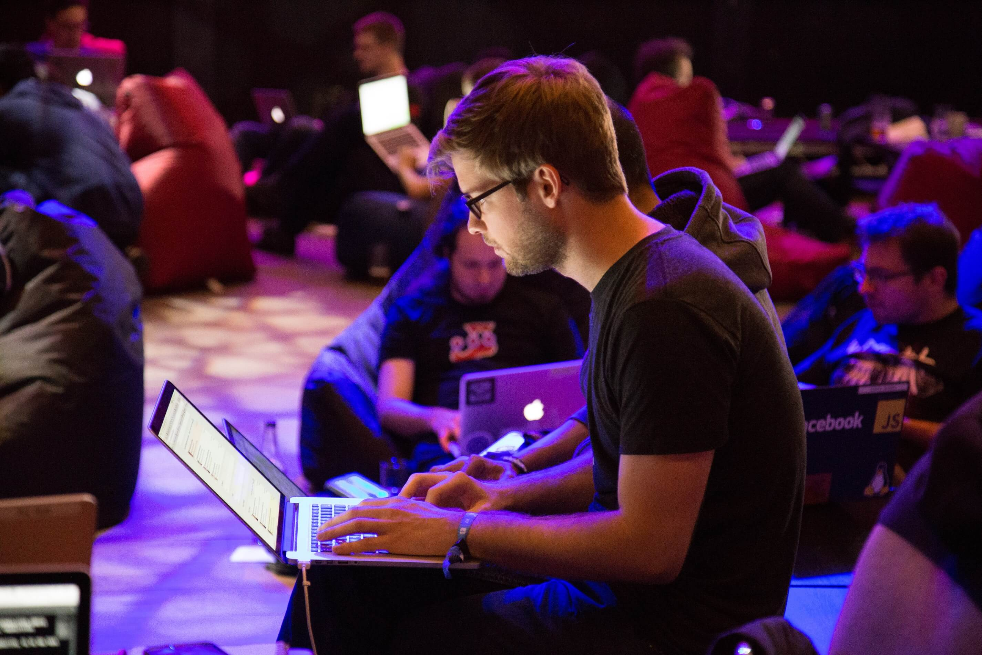
Why Testoper?

Slide 3

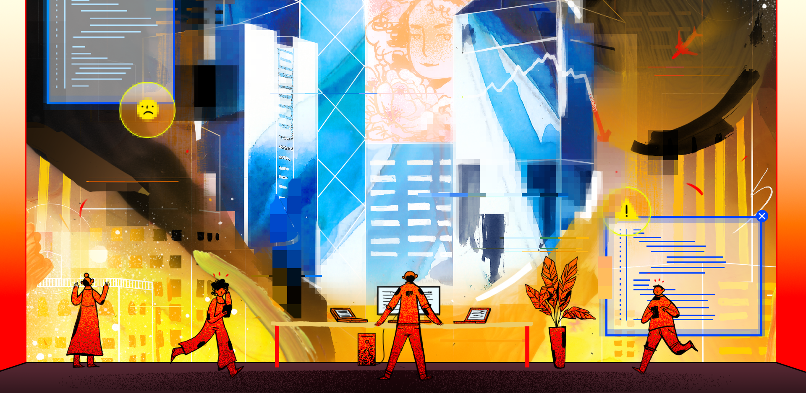
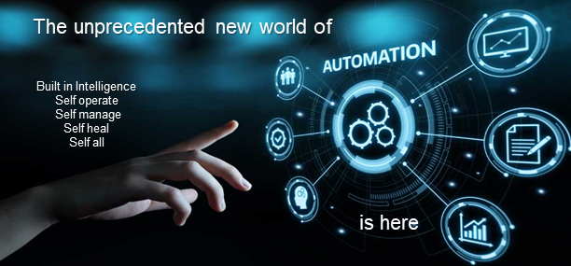

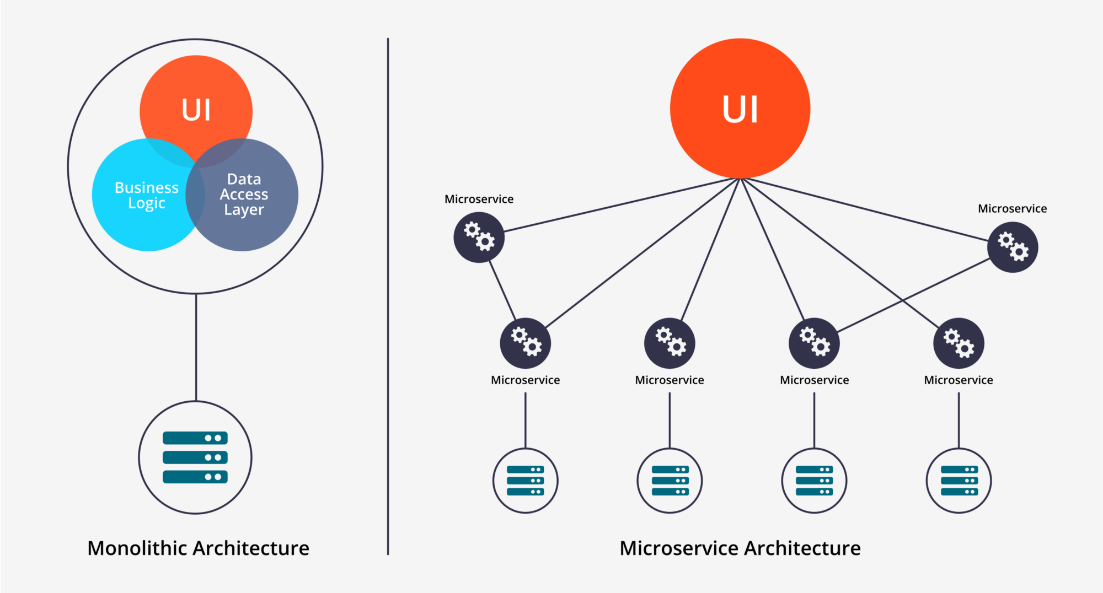
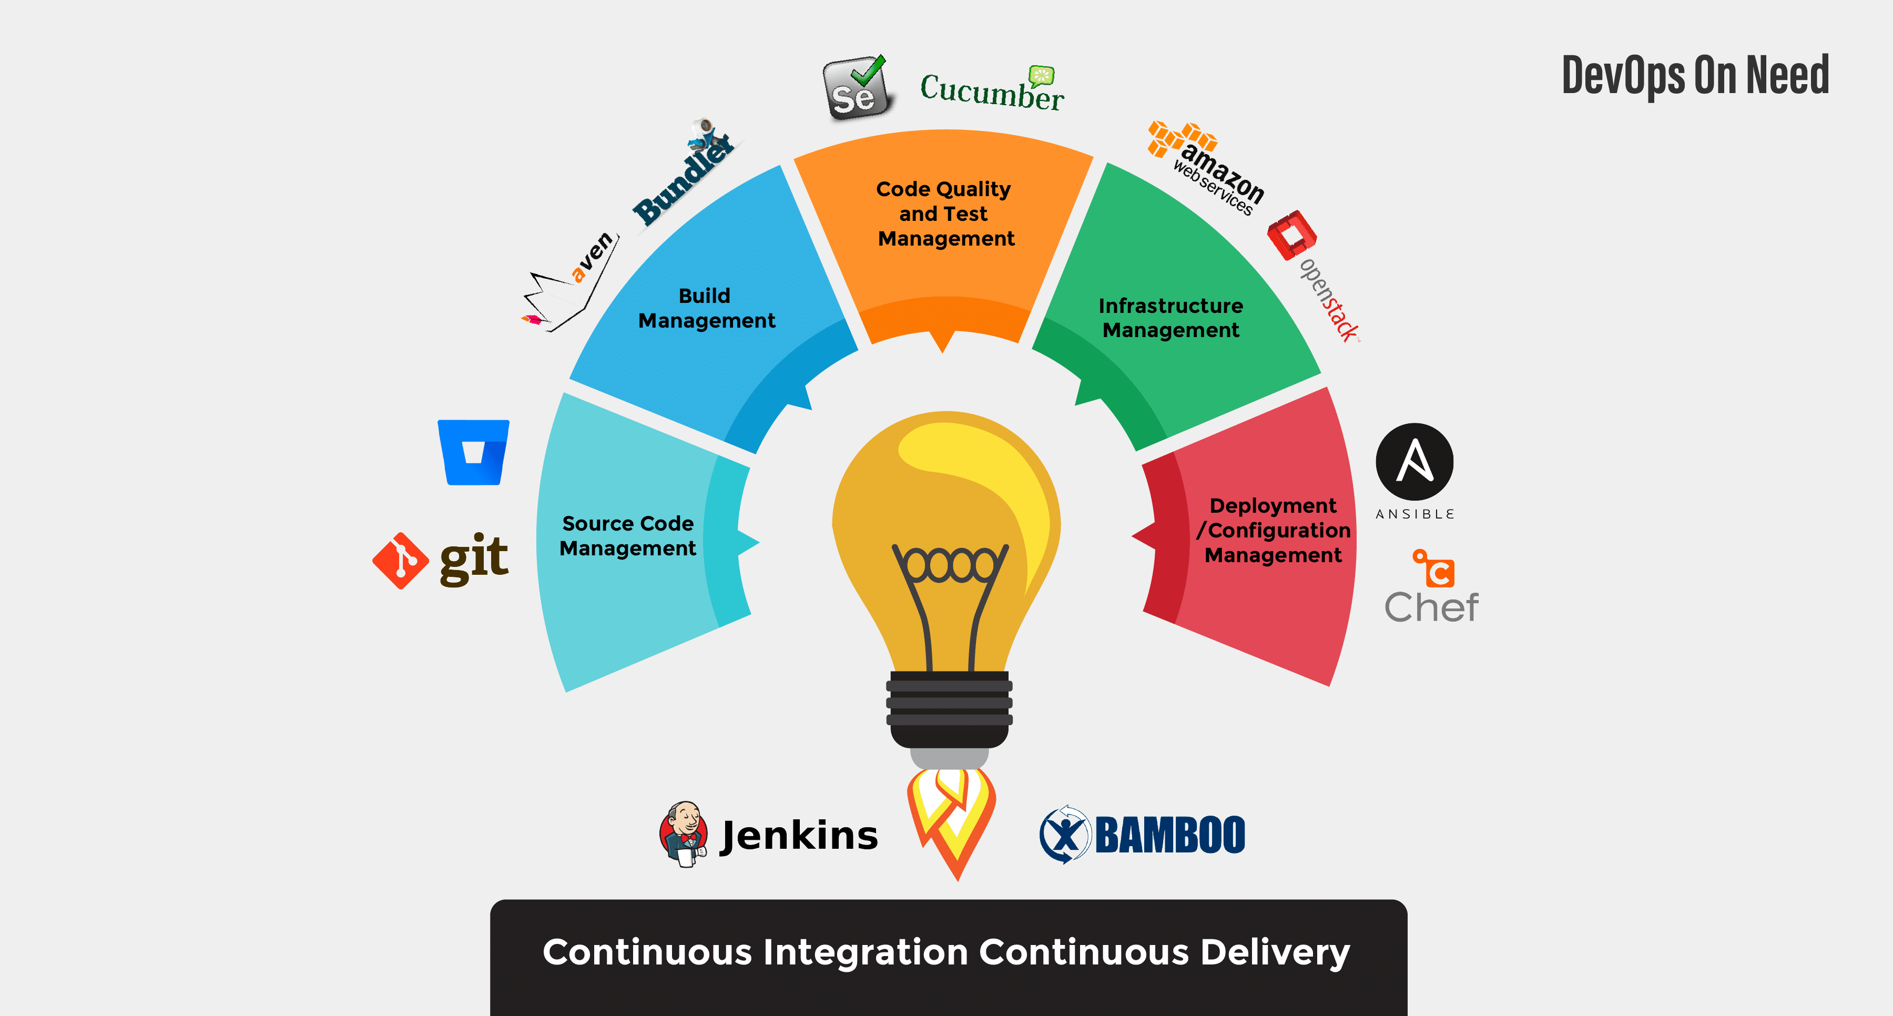
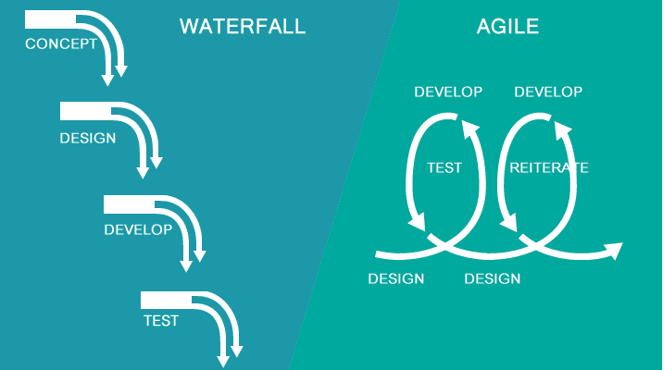
1
2
Imagine a world without “Delivering and Operating High-Quality Product”
To reap real automation benefit, “we now have to tackle complexity”
Dangerous world of chaos, monetary, and human loss
The digital transformation comes with greater complexity
Technological advancement
Architectural advancement
Technical advancement
Process advancement
3

Slide 4


More than ever given the complexity calls for smarter and creative talent for “delivering and operating high-quality product”;
calls for disruptive Innovation, unprecedented Intrapreneurship and Entrepreneurship;
the world needs a little more of from you (AIM);
the world needs a Testoper;

Slide 5
About Testoper

Slide 6



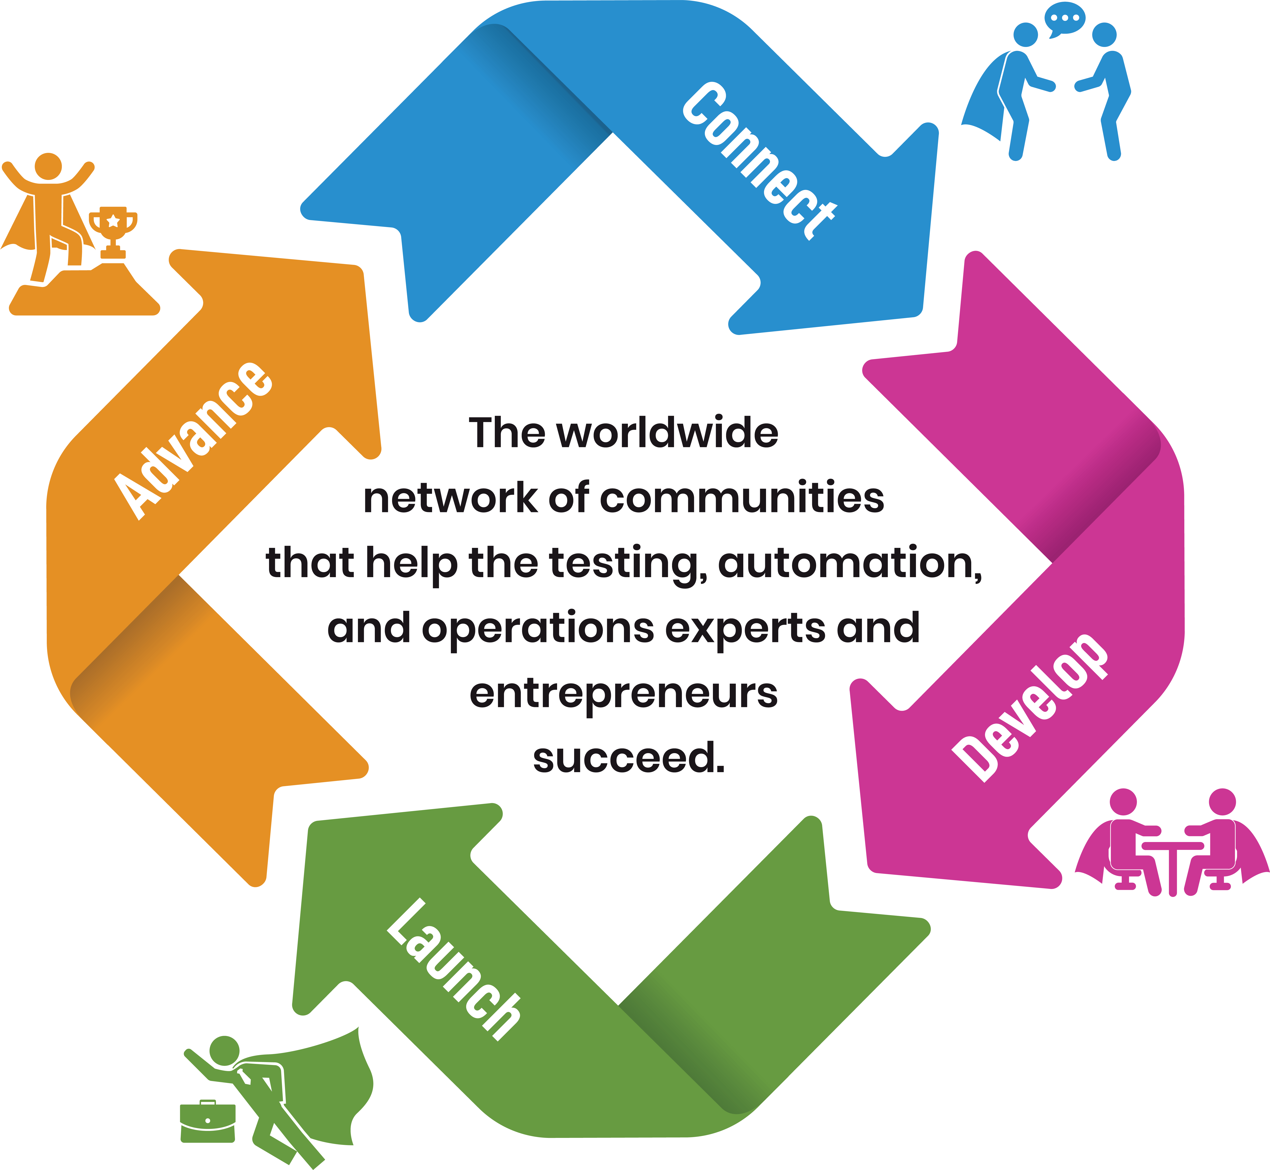
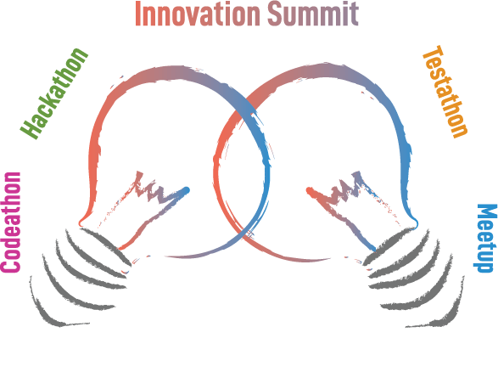
We enable creative talent to accelerate the pace of innovation for delivering and operating high-quality products. As a result, we empower enterprise, government, academics, and individuals to create social impact and economic growth.
6
Notes:
Social impact - well being of individuals and families, livability and oppurtunities
Economic Growth - is an increase in the production of goods and services in an economy.
Livability, prosperity, and opportunity. Address skill challenge in the digital transformation world…

Slide 7









How
do it
we
Note: Refer Program Catalog to know details of each program
7

Slide 8
About Testoper Codethon

Slide 9

Why Testoper Codeathon?
The Testoper Codeathon is a deep dive coding bi-weekly program delivered by the collaborative engagement of community experts for the community members who are dedicated and inspired to play the role of an expert in future innovation for delivering and operating high quality products.
Who should attend Testoper Codeathon?
Architects, designers, and developers to learn test automation and operations skills in the world of agile to become the overall expert
Testers and operations professional to learn test automation and intelligent automation to advance career
The individuals who are hungry to stand out of the crowd and passionate about innovation in everything they do
The individuals who are determined to make a difference at work as an Intrapreneur delivering continuous improvement
And, for individuals to connect, develop, launch, and advance their Entrepreneur dreams into reality
What is the end GOAL and expected outcome?
Creative Talent
Job opportunity
Innovation, Intrapreneurship and Entrepreneurship
9

Slide 10

Intended Program Content
Intelligent Automation (1 hour)
XXX
XXX
XXX
XXX
XXX
XXX
XXX
XXX
XXX
XXX
XXX
XXX
XXX
XXX
XXX
Test Automation and TestOps (1 hour)
XXX
XXX
XXX
XXX
XXX
XXX
XXX
XXX
XXX
XXX
XXX
XXX
XXX
XXX
XXX
Note: Refer the details at https://github.com/testoper/Codeathon
10

Slide 11
Prerequisite, Program and Team Split
Team IA
XXX
XXX
XXX
XXX
XXX
XXX
XXX
XXX
XXX
XXX
XXX
XXX
XXX
XXX
XXX
Team TO
XXX
XXX
XXX
XXX
XXX
XXX
XXX
XXX
XXX
XXX
XXX
XXX
XXX
XXX
XXX
Team Beginners
No Programming Skills
Not a fit in Team IA
Not a fir in Team TO
Note: We will be sending out the survey next days for you to choose the team and provide details to get to know you better
11

Slide 12
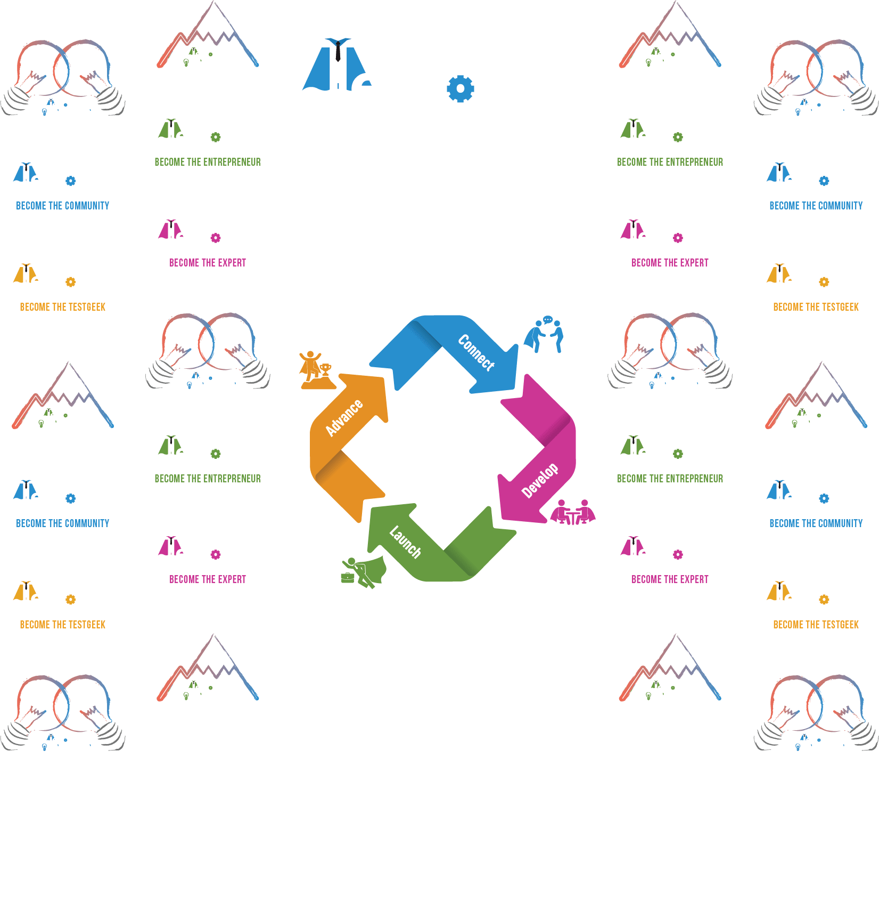

Slide 13
Additional References
https://www.meetup.com/testoper/
https://join.slack.com/t/testoperworkspace/shared_invite/enQtNjQxNDUxMzA3Mzk5LWU3ZGNmMWE1NDgxYTU3ZTUyNWViODZhMzVlNmQ1MzVmYzM2NWQzOWY2ZDcwOWNkZTUxNDQ0NTY4ODQ3NjNhNjg
https://www.linkedin.com/groups/12273365/
https://www.linkedin.com/company/testoper/
https://github.com/testoper
https://twitter.com/Test_oper
https://www.facebook.com/Testoper-2259707950907991
https://www.eventbrite.com/o/testoper-community-28935529723
https://testoper.com/
Email: testoper@testoper.com , Ph: +1-647 998 1977
13

